Slide 1



ipl
View in Power BI
Last data refresh:
6/5/2025 7:02:07 PM UTC
Downloaded at:
6/20/2025 1:08:34 AM UTC

Slide 2
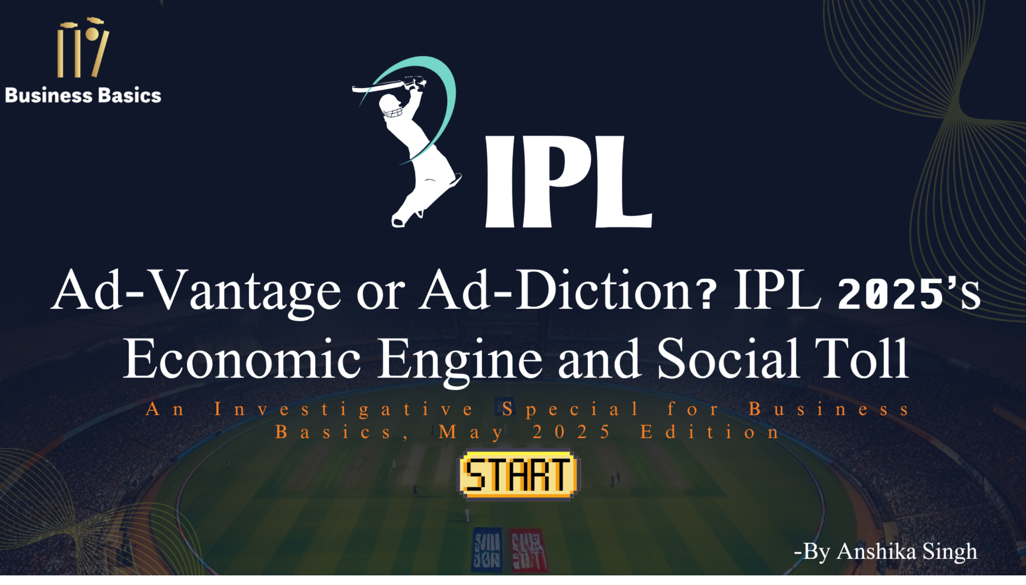
Main
Notes:
actionButton
No alt text provided

Slide 3
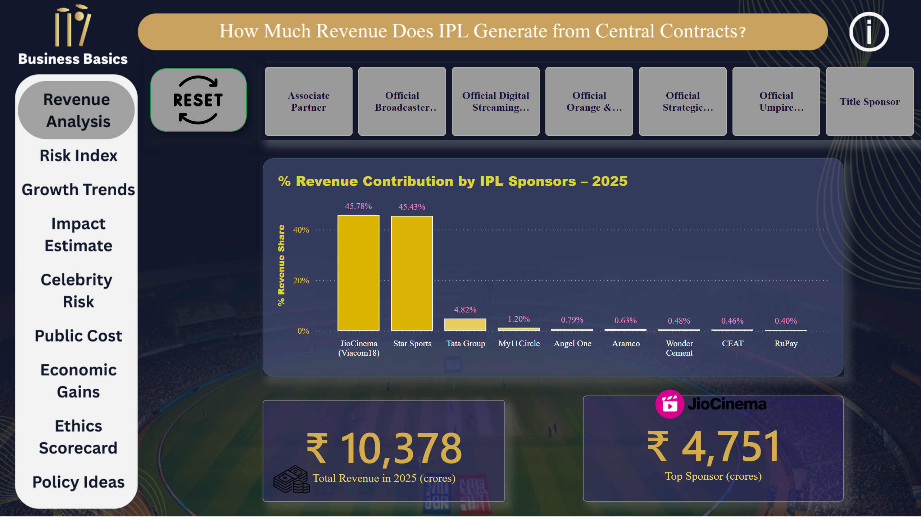
Revenue Analysis
Notes:
card
No alt text provided
% Revenue Contribution by IPL Sponsors – 2025
No alt text provided
card
No alt text provided
image
No alt text provided
image
No alt text provided
advancedSlicerVisual
No alt text provided
image
No alt text provided
shape
No alt text provided
shape
No alt text provided
actionButton
No alt text provided
textbox
No alt text provided
actionButton
No alt text provided
actionButton
No alt text provided
actionButton
No alt text provided
actionButton
No alt text provided
actionButton
No alt text provided
actionButton
No alt text provided
actionButton
No alt text provided
actionButton
No alt text provided
actionButton
No alt text provided
actionButton
No alt text provided
actionButton
No alt text provided

Slide 4
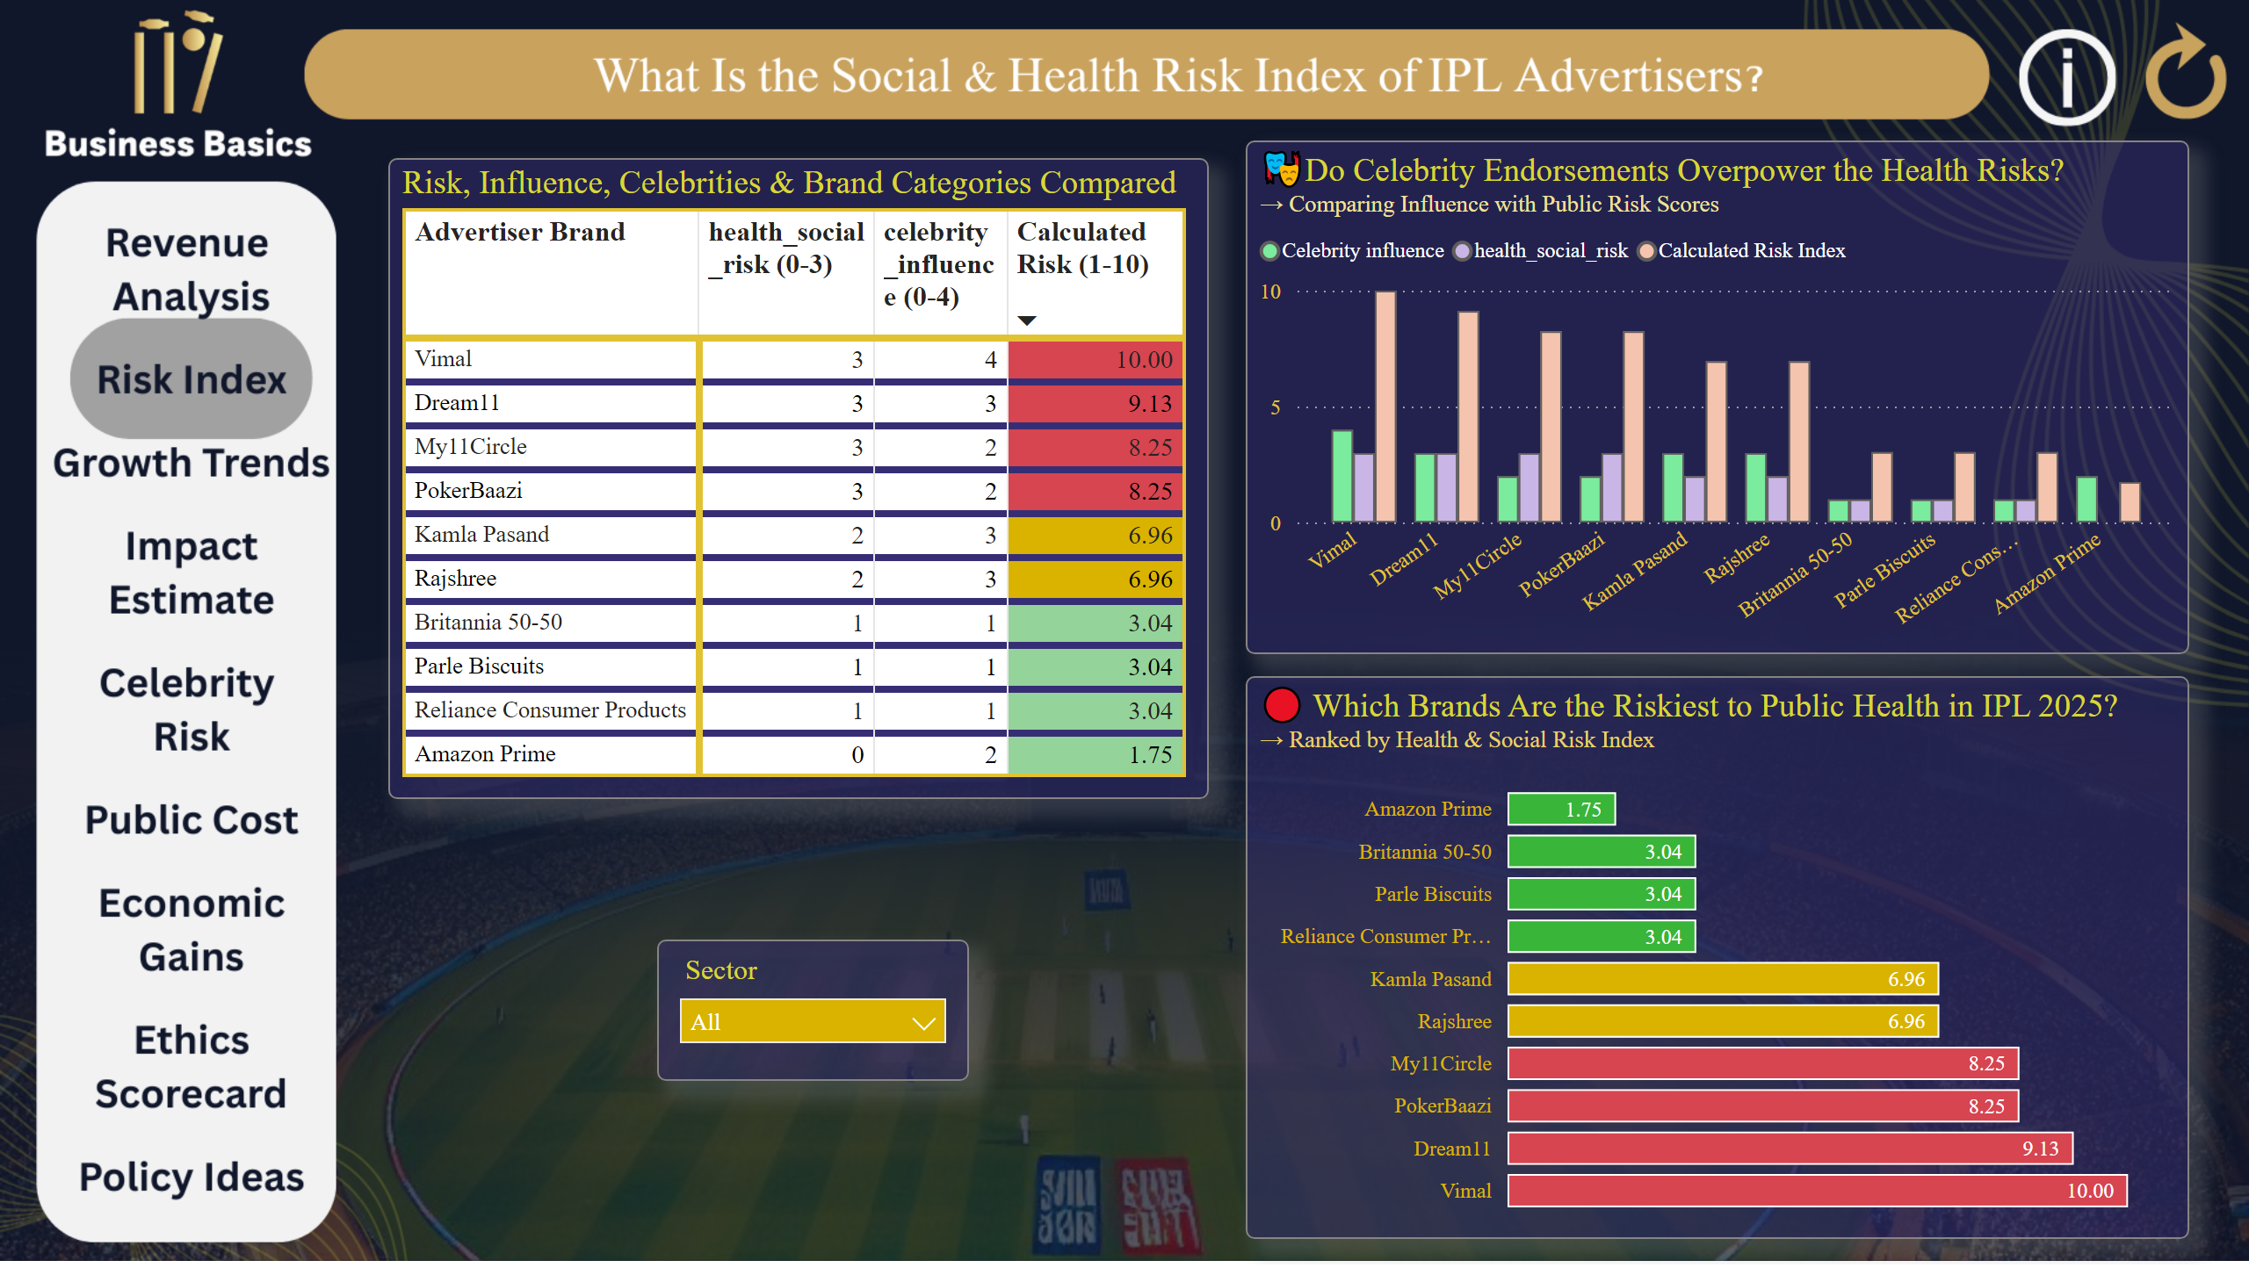
Risk Index
Notes:
🔴 Which Brands Are the Riskiest to Public Health in IPL 2025?
No alt text provided
🎭Do Celebrity Endorsements Overpower the Health Risks?
No alt text provided
Risk, Influence, Celebrities & Brand Categories Compared
No alt text provided
slicer
No alt text provided
textbox
No alt text provided
actionButton
No alt text provided
actionButton
No alt text provided
actionButton
No alt text provided
actionButton
No alt text provided
actionButton
No alt text provided
actionButton
No alt text provided
actionButton
No alt text provided
actionButton
No alt text provided
actionButton
No alt text provided
actionButton
No alt text provided
actionButton
No alt text provided
actionButton
No alt text provided
actionButton
No alt text provided

Slide 5
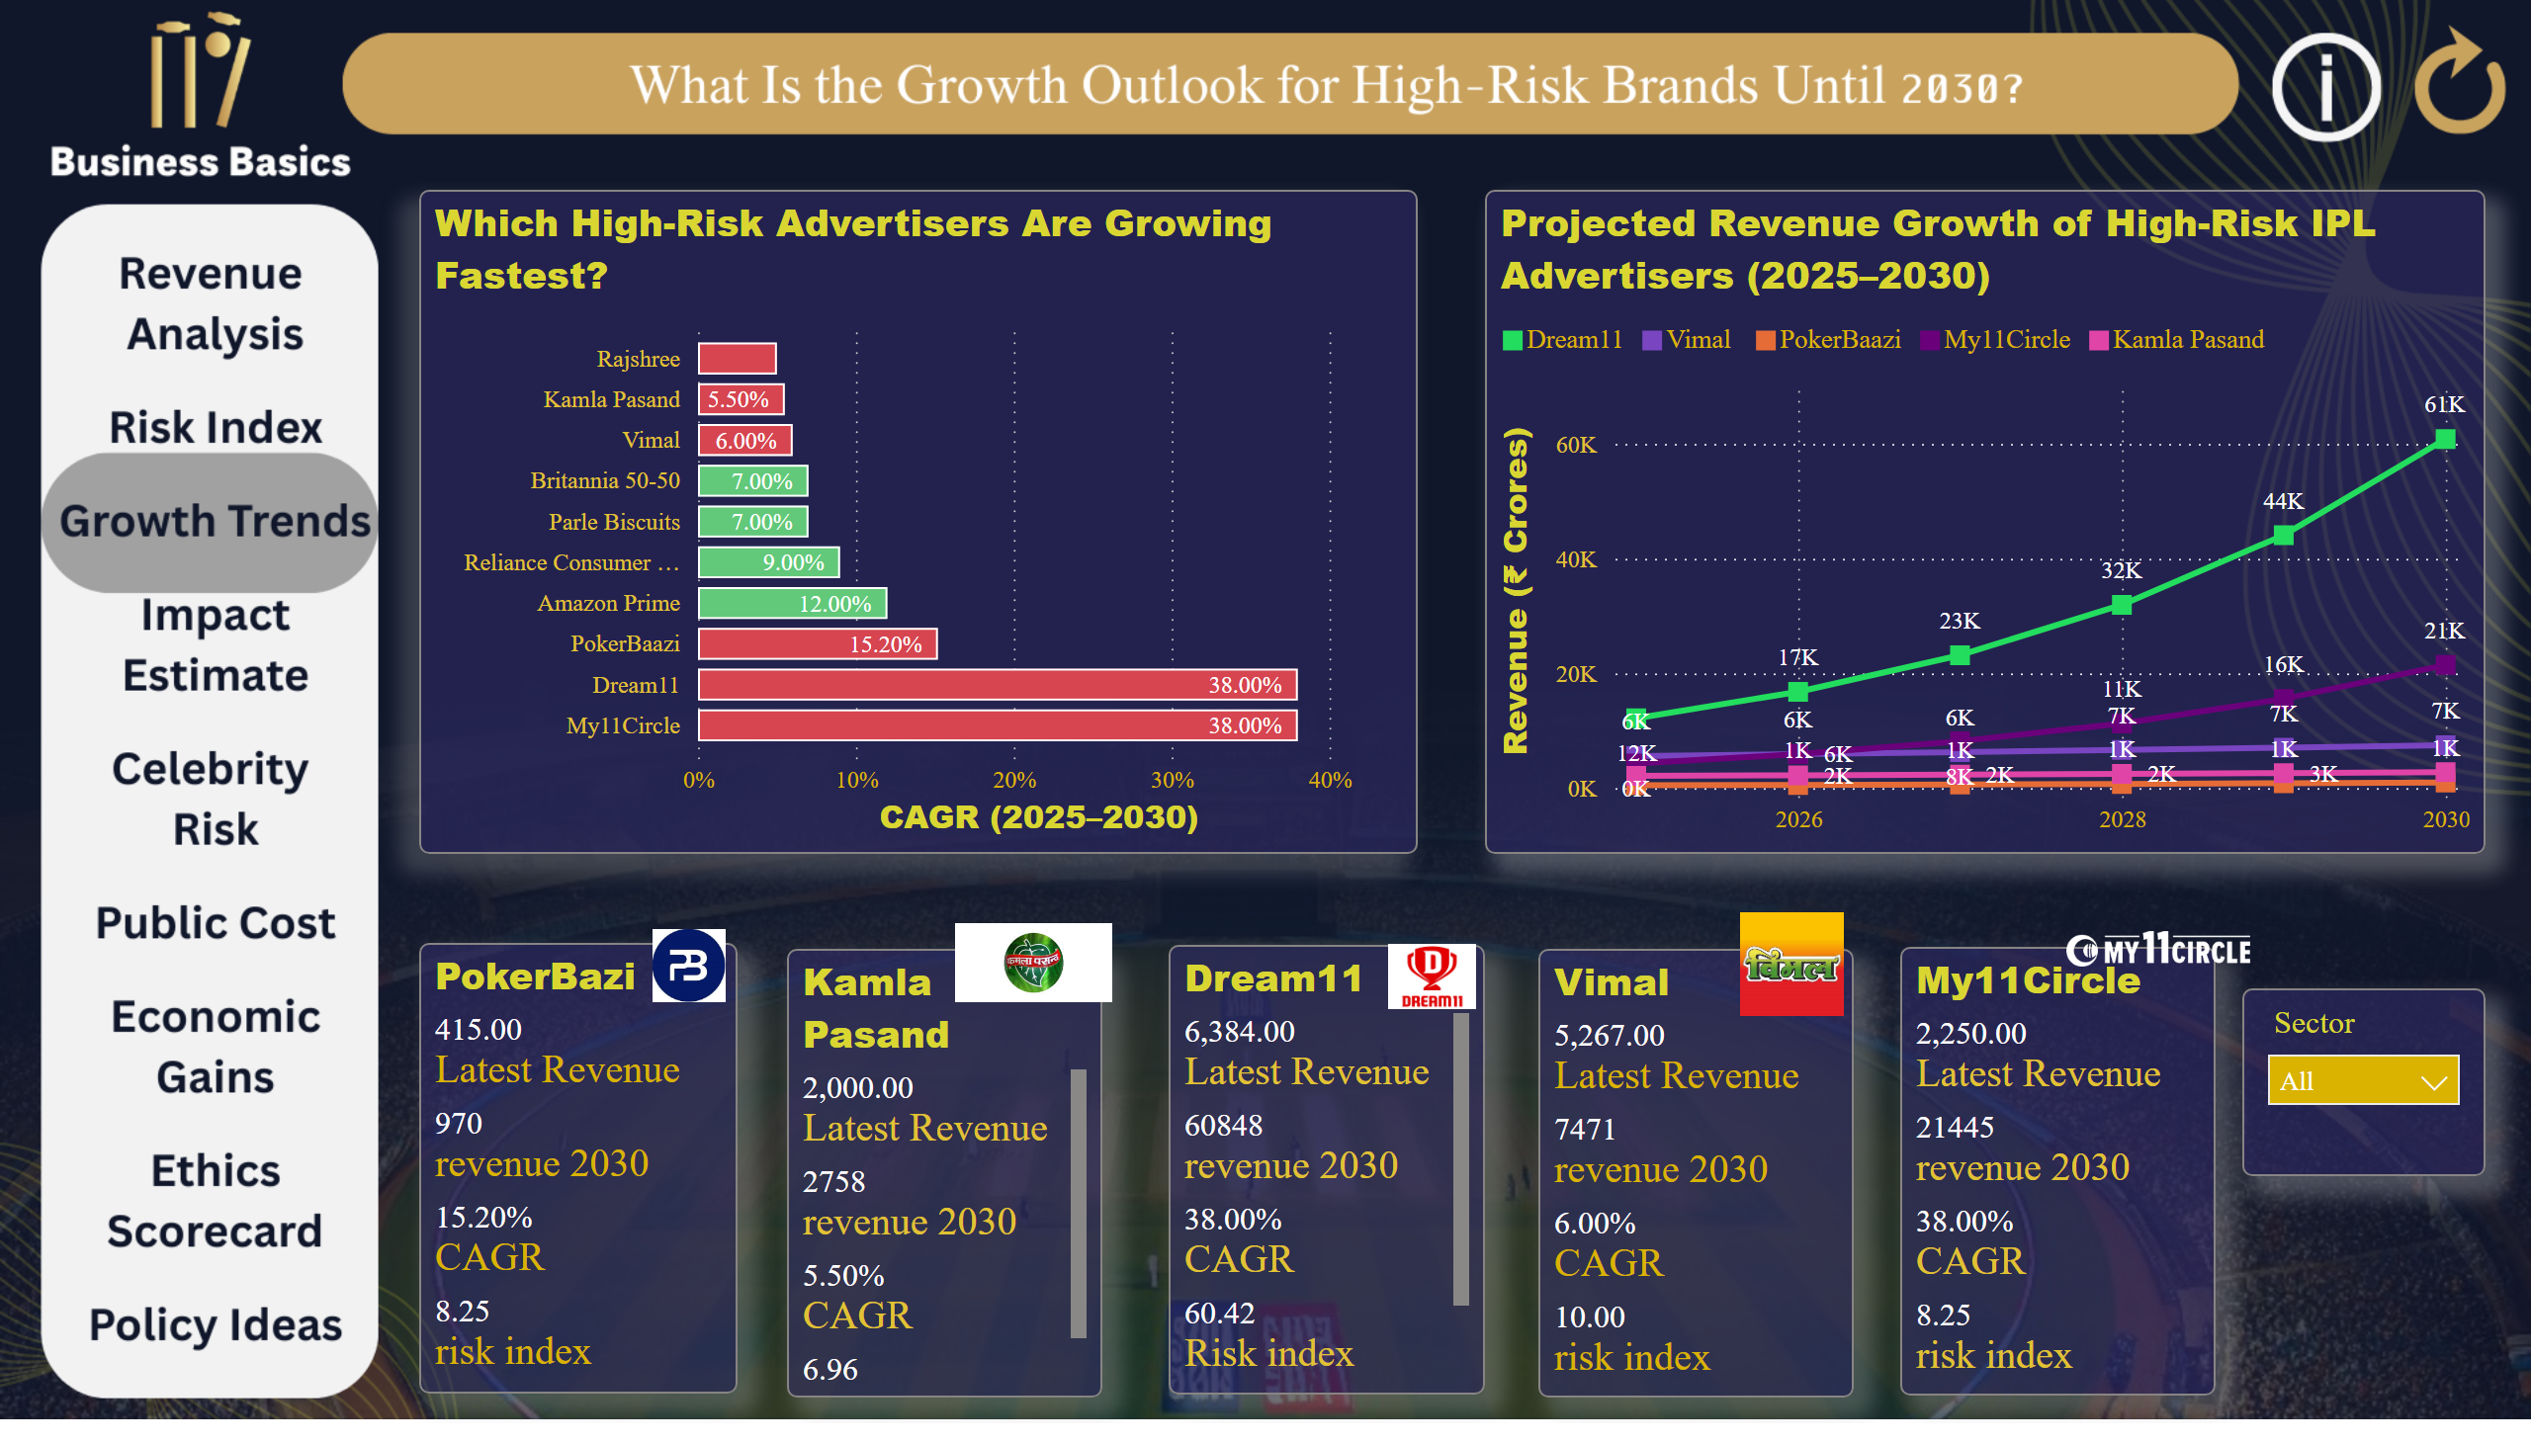
Growth Trends
Notes:
Which High-Risk Advertisers Are Growing Fastest?
No alt text provided
Projected Revenue Growth of High-Risk IPL Advertisers (2025–2030)
No alt text provided
Dream11
No alt text provided
PokerBazi
No alt text provided
Vimal
No alt text provided
My11Circle
No alt text provided
Kamla Pasand
No alt text provided
textbox
No alt text provided
image
No alt text provided
image
No alt text provided
image
No alt text provided
image
No alt text provided
image
No alt text provided
slicer
No alt text provided
actionButton
No alt text provided
actionButton
No alt text provided
actionButton
No alt text provided
actionButton
No alt text provided
actionButton
No alt text provided
actionButton
No alt text provided
actionButton
No alt text provided
actionButton
No alt text provided
actionButton
No alt text provided
actionButton
No alt text provided
actionButton
No alt text provided
actionButton
No alt text provided

Slide 6
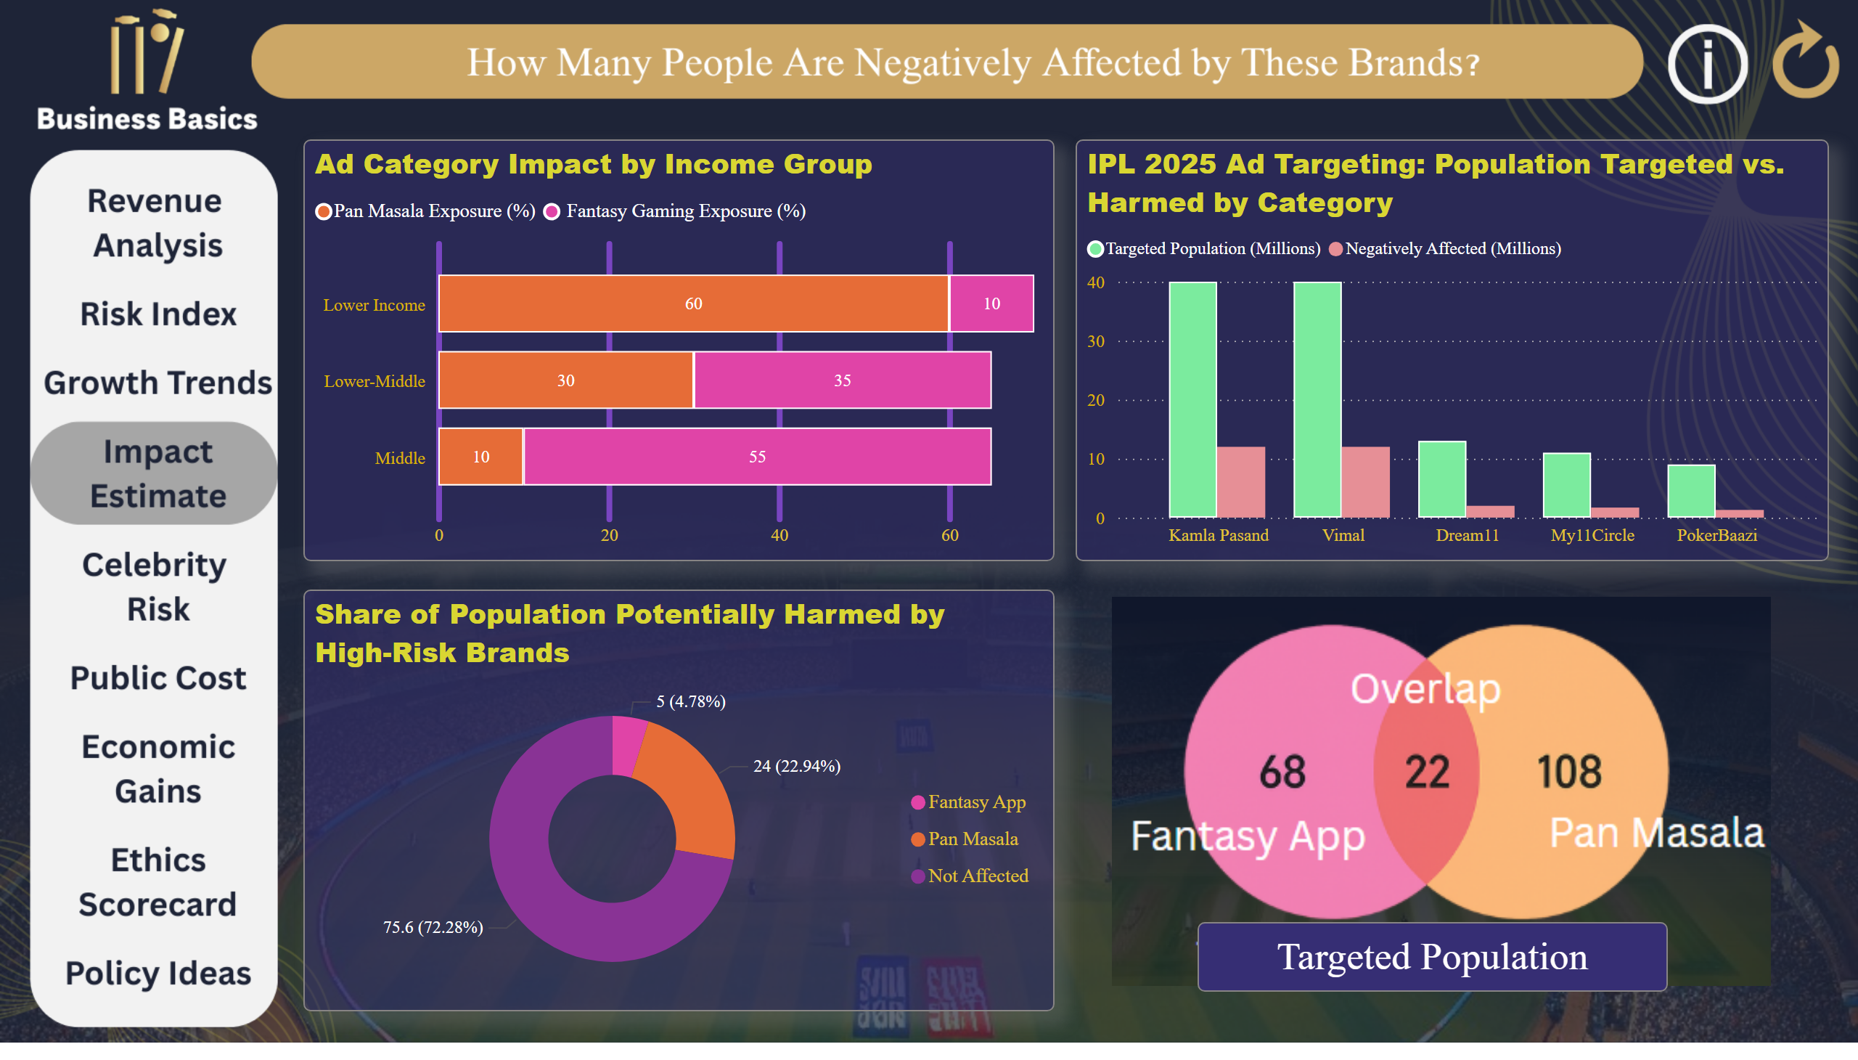
Impact Estimate
Notes:
Share of Population Potentially Harmed by High-Risk Brands
No alt text provided
Ad Category Impact by Income Group
No alt text provided
textbox
No alt text provided
IPL 2025 Ad Targeting: Population Targeted vs. Harmed by Category
No alt text provided
actionButton
No alt text provided
actionButton
No alt text provided
actionButton
No alt text provided
actionButton
No alt text provided
actionButton
No alt text provided
actionButton
No alt text provided
actionButton
No alt text provided
actionButton
No alt text provided
actionButton
No alt text provided
actionButton
No alt text provided
actionButton
No alt text provided
actionButton
No alt text provided
image
No alt text provided
actionButton
No alt text provided
actionButton
No alt text provided
textbox
No alt text provided
actionButton
No alt text provided

Slide 7
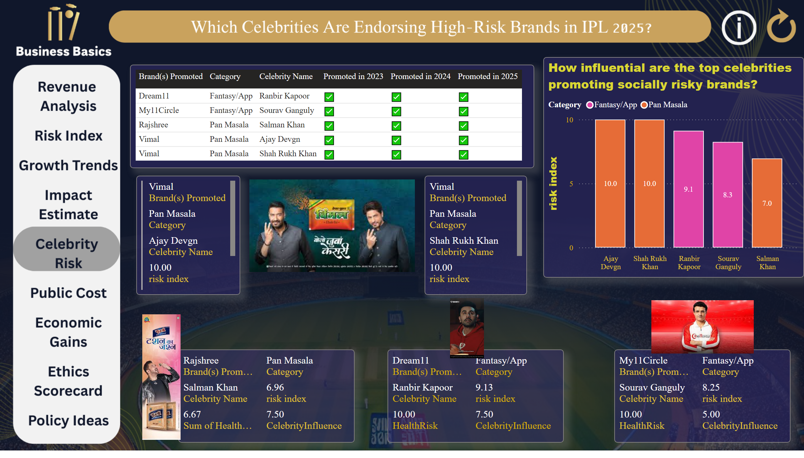
Celebrity Risk
Notes:
tableEx
No alt text provided
How influential are the top celebrities promoting socially risky brands?
No alt text provided
multiRowCard
No alt text provided
textbox
No alt text provided
multiRowCard
No alt text provided
multiRowCard
No alt text provided
multiRowCard
No alt text provided
multiRowCard
No alt text provided
image
No alt text provided
image
No alt text provided
image
No alt text provided
image
No alt text provided
actionButton
No alt text provided
actionButton
No alt text provided
actionButton
No alt text provided
actionButton
No alt text provided
actionButton
No alt text provided
actionButton
No alt text provided
actionButton
No alt text provided
actionButton
No alt text provided
actionButton
No alt text provided
actionButton
No alt text provided
actionButton
No alt text provided
actionButton
No alt text provided
actionButton
No alt text provided
actionButton
No alt text provided

Slide 8
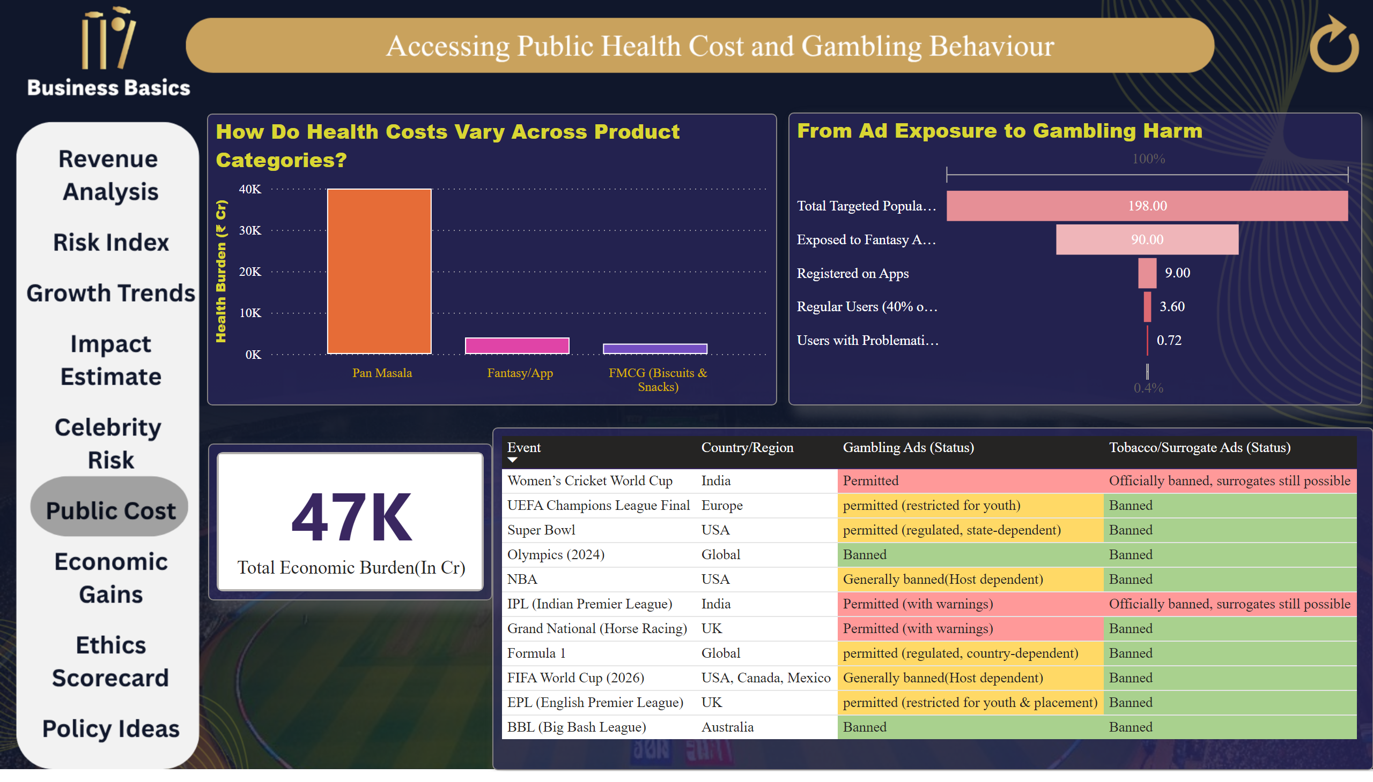
Public Cost
Notes:
How Do Health Costs Vary Across Product Categories?
No alt text provided
cardVisual
No alt text provided
tableEx
No alt text provided
From Ad Exposure to Gambling Harm
No alt text provided
actionButton
No alt text provided
actionButton
No alt text provided
actionButton
No alt text provided
actionButton
No alt text provided
actionButton
No alt text provided
actionButton
No alt text provided
actionButton
No alt text provided
actionButton
No alt text provided
actionButton
No alt text provided
actionButton
No alt text provided
actionButton
No alt text provided
actionButton
No alt text provided
actionButton
No alt text provided

Slide 9
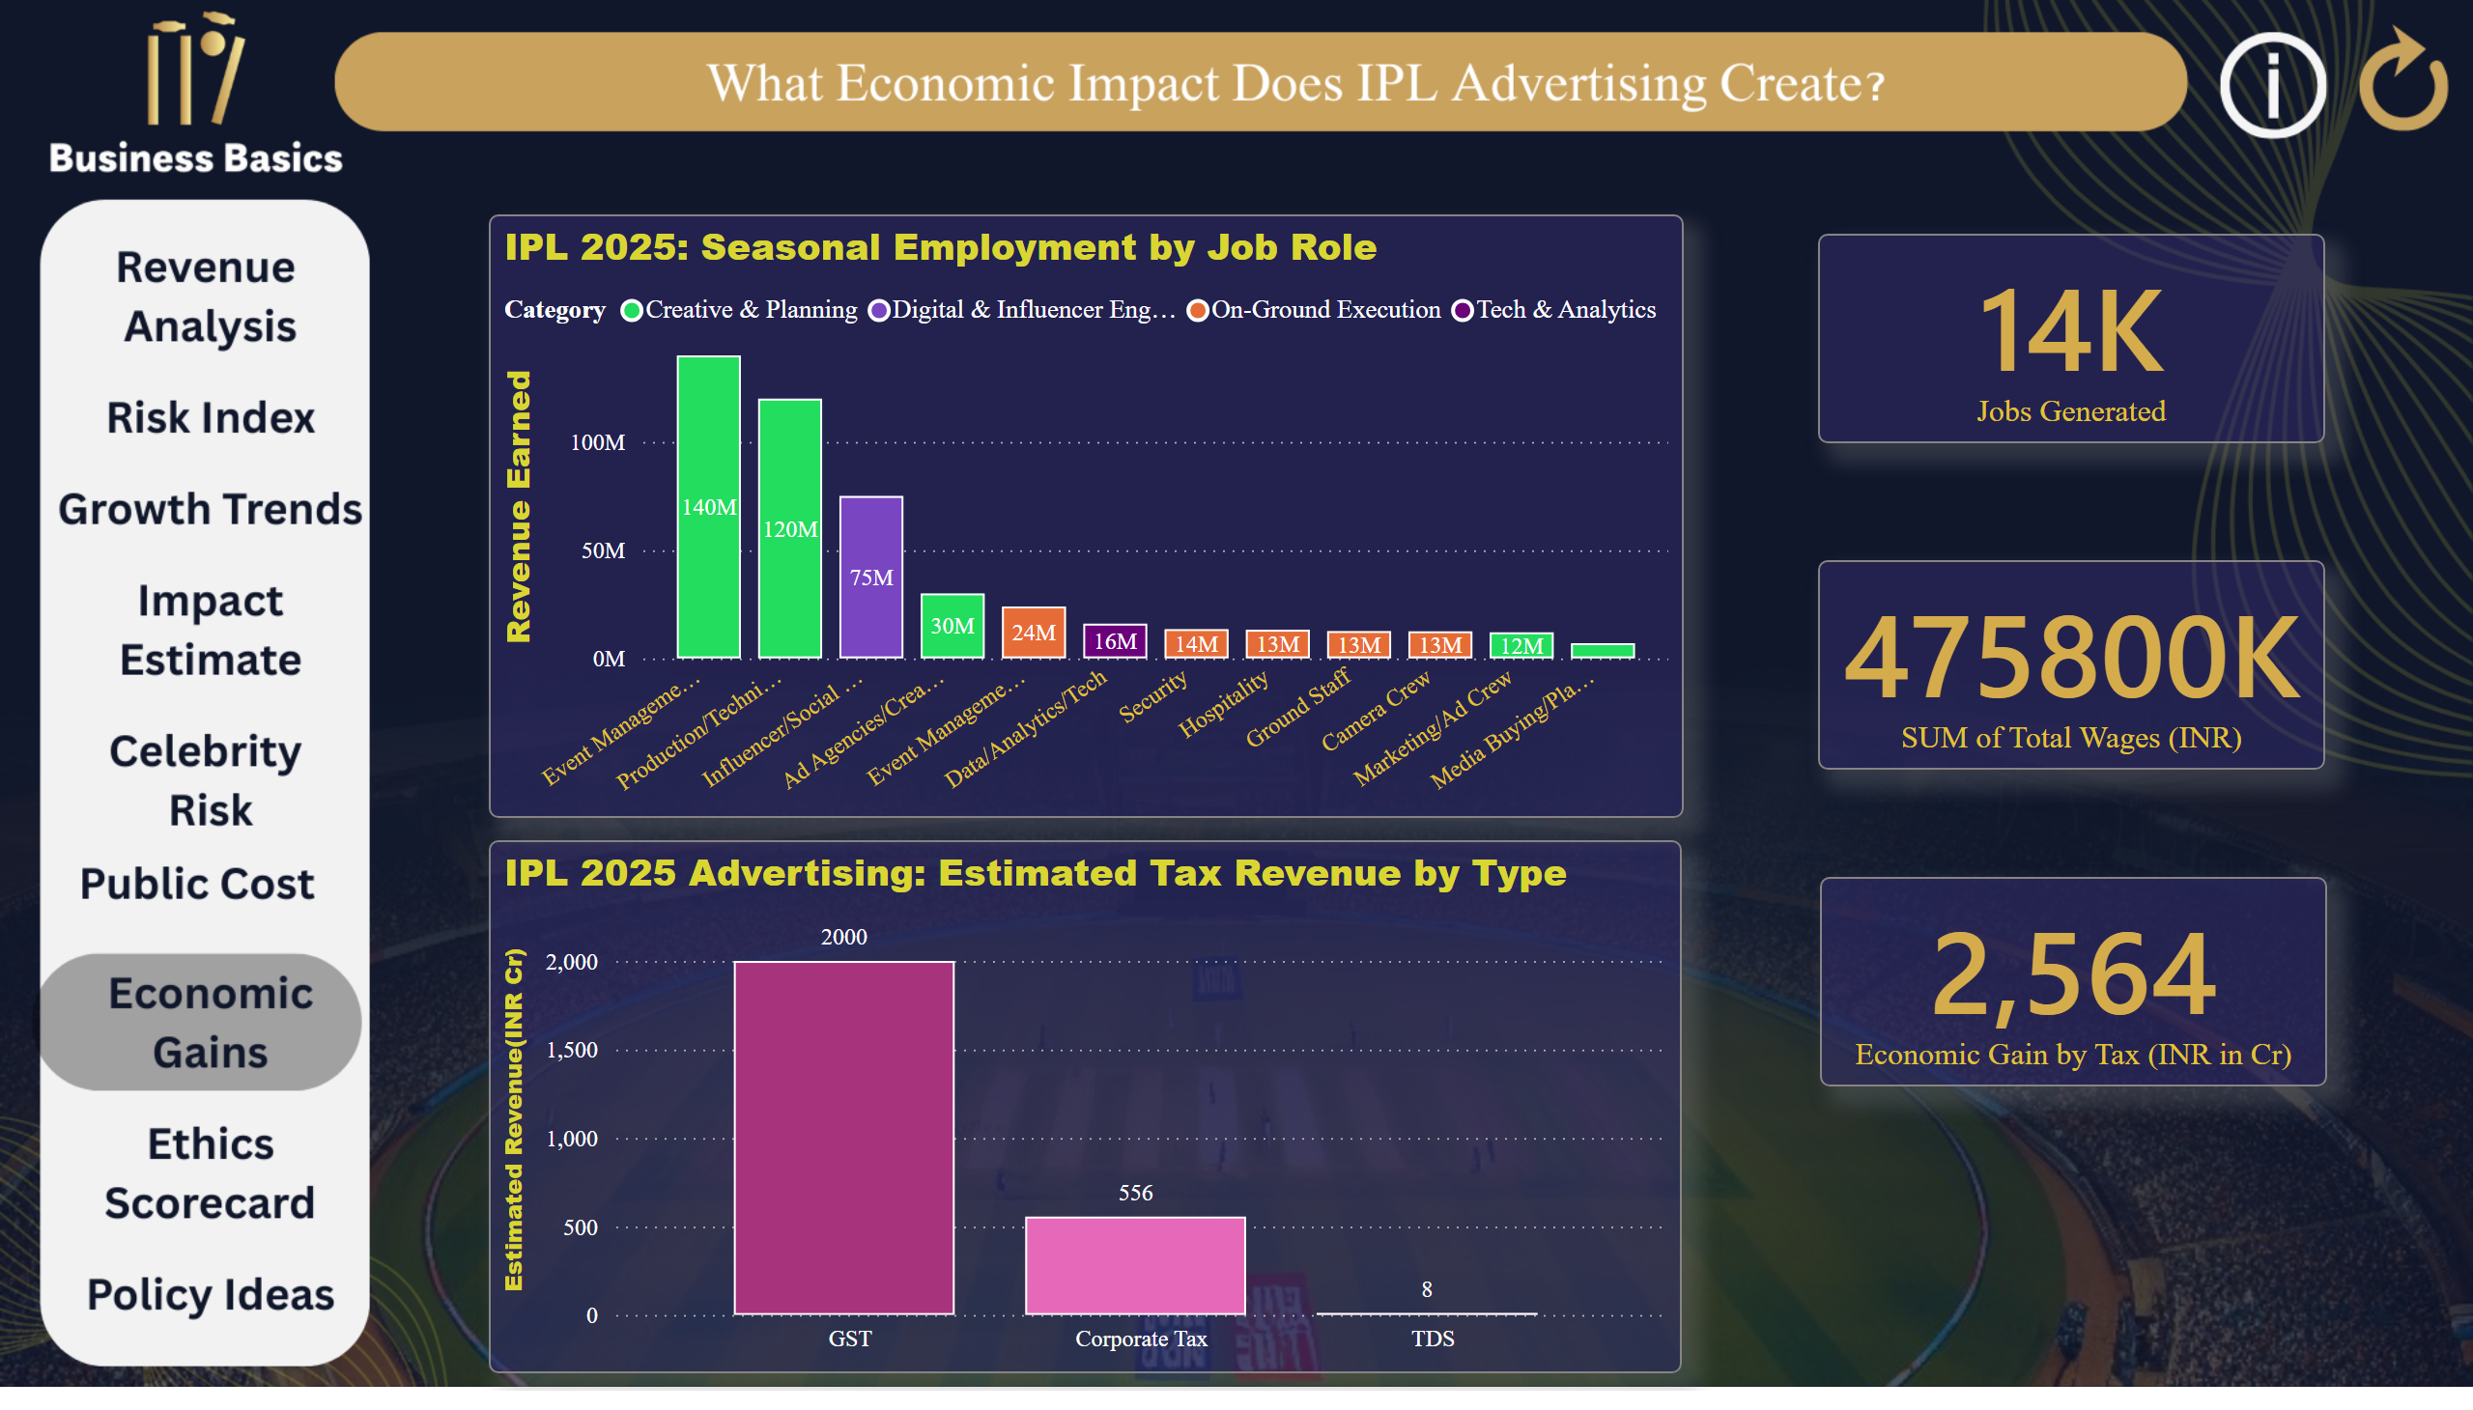
Economic Gain
Notes:
IPL 2025 Advertising: Estimated Tax Revenue by Type
No alt text provided
card
No alt text provided
IPL 2025: Seasonal Employment by Job Role
No alt text provided
card
No alt text provided
card
No alt text provided
textbox
No alt text provided
actionButton
No alt text provided
actionButton
No alt text provided
actionButton
No alt text provided
actionButton
No alt text provided
actionButton
No alt text provided
actionButton
No alt text provided
actionButton
No alt text provided
actionButton
No alt text provided
actionButton
No alt text provided
actionButton
No alt text provided
actionButton
No alt text provided
actionButton
No alt text provided
actionButton
No alt text provided
actionButton
No alt text provided
actionButton
No alt text provided
actionButton
No alt text provided
actionButton
No alt text provided
actionButton
No alt text provided

Slide 10
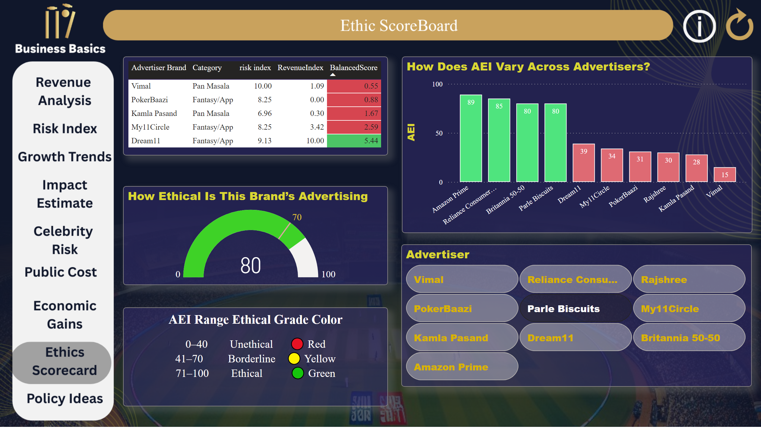
Ethics Scorecard
Notes:
tableEx
No alt text provided
How Ethical Is This Brand’s Advertising
No alt text provided
How Does AEI Vary Across Advertisers?
No alt text provided
advancedSlicerVisual
No alt text provided
textbox
No alt text provided
textbox
No alt text provided
actionButton
No alt text provided
actionButton
No alt text provided
actionButton
No alt text provided
actionButton
No alt text provided
actionButton
No alt text provided
actionButton
No alt text provided
actionButton
No alt text provided
actionButton
No alt text provided
actionButton
No alt text provided
actionButton
No alt text provided
actionButton
No alt text provided
actionButton
No alt text provided

Slide 11
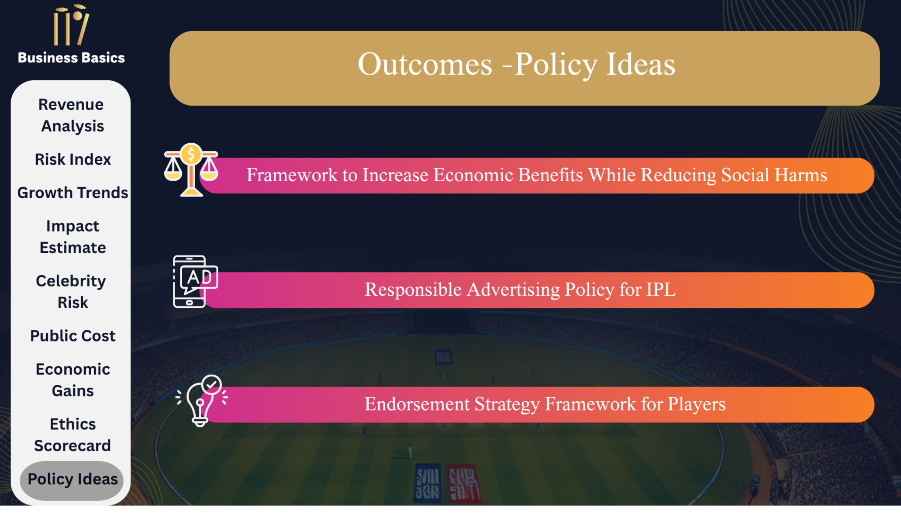
Policy Ideas
Notes:
actionButton
No alt text provided
actionButton
No alt text provided
actionButton
No alt text provided
actionButton
No alt text provided
actionButton
No alt text provided
actionButton
No alt text provided
actionButton
No alt text provided
actionButton
No alt text provided
actionButton
No alt text provided
actionButton
No alt text provided
actionButton
No alt text provided
actionButton
No alt text provided

Slide 12
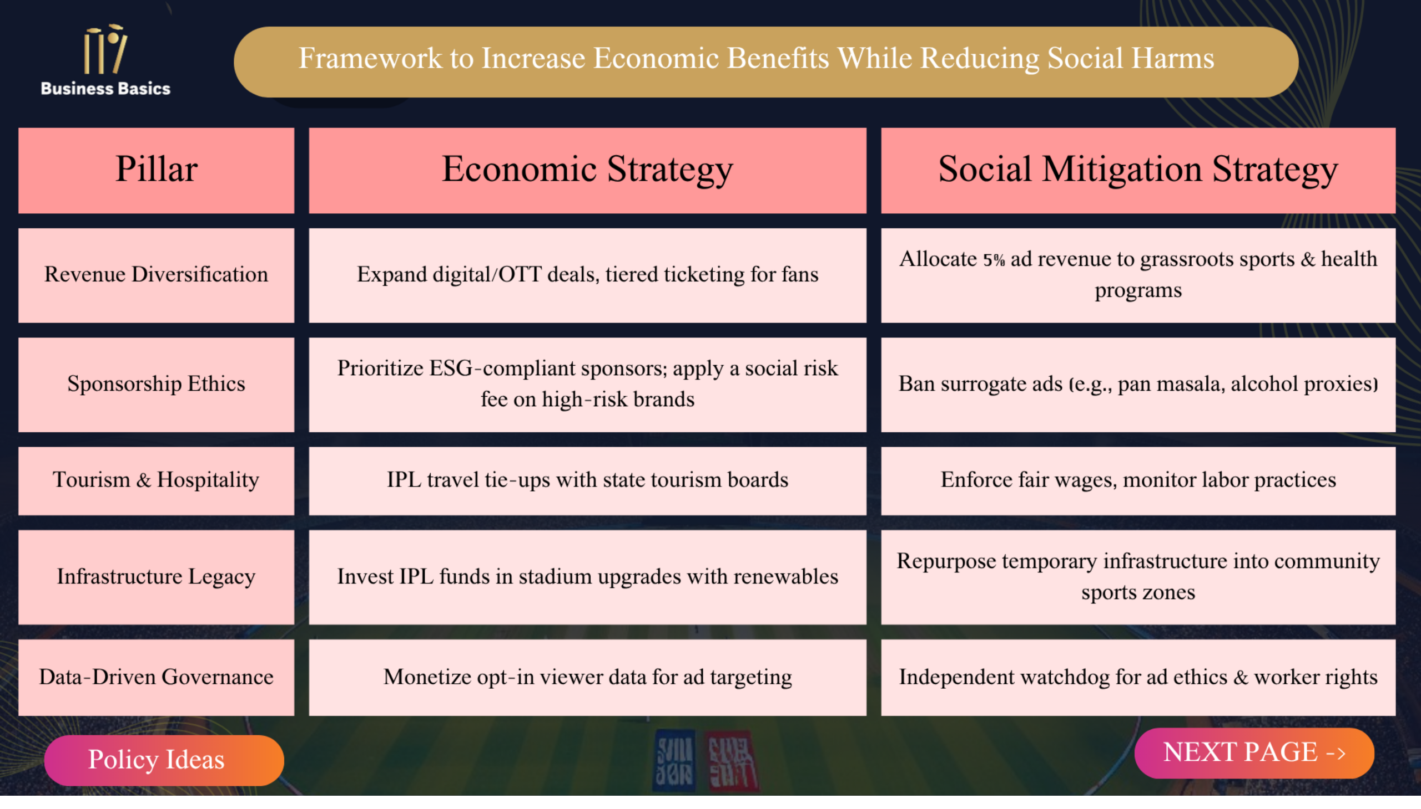
Page 1
Notes:
actionButton
No alt text provided
actionButton
No alt text provided
actionButton
No alt text provided

Slide 13
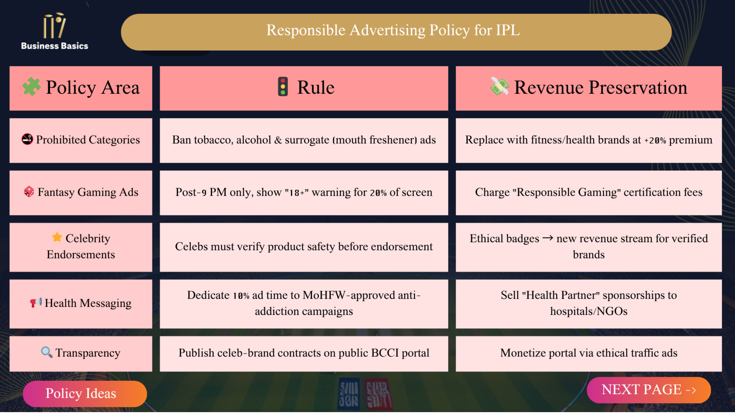
Page 2
Notes:
actionButton
No alt text provided
actionButton
No alt text provided
actionButton
No alt text provided

Slide 14
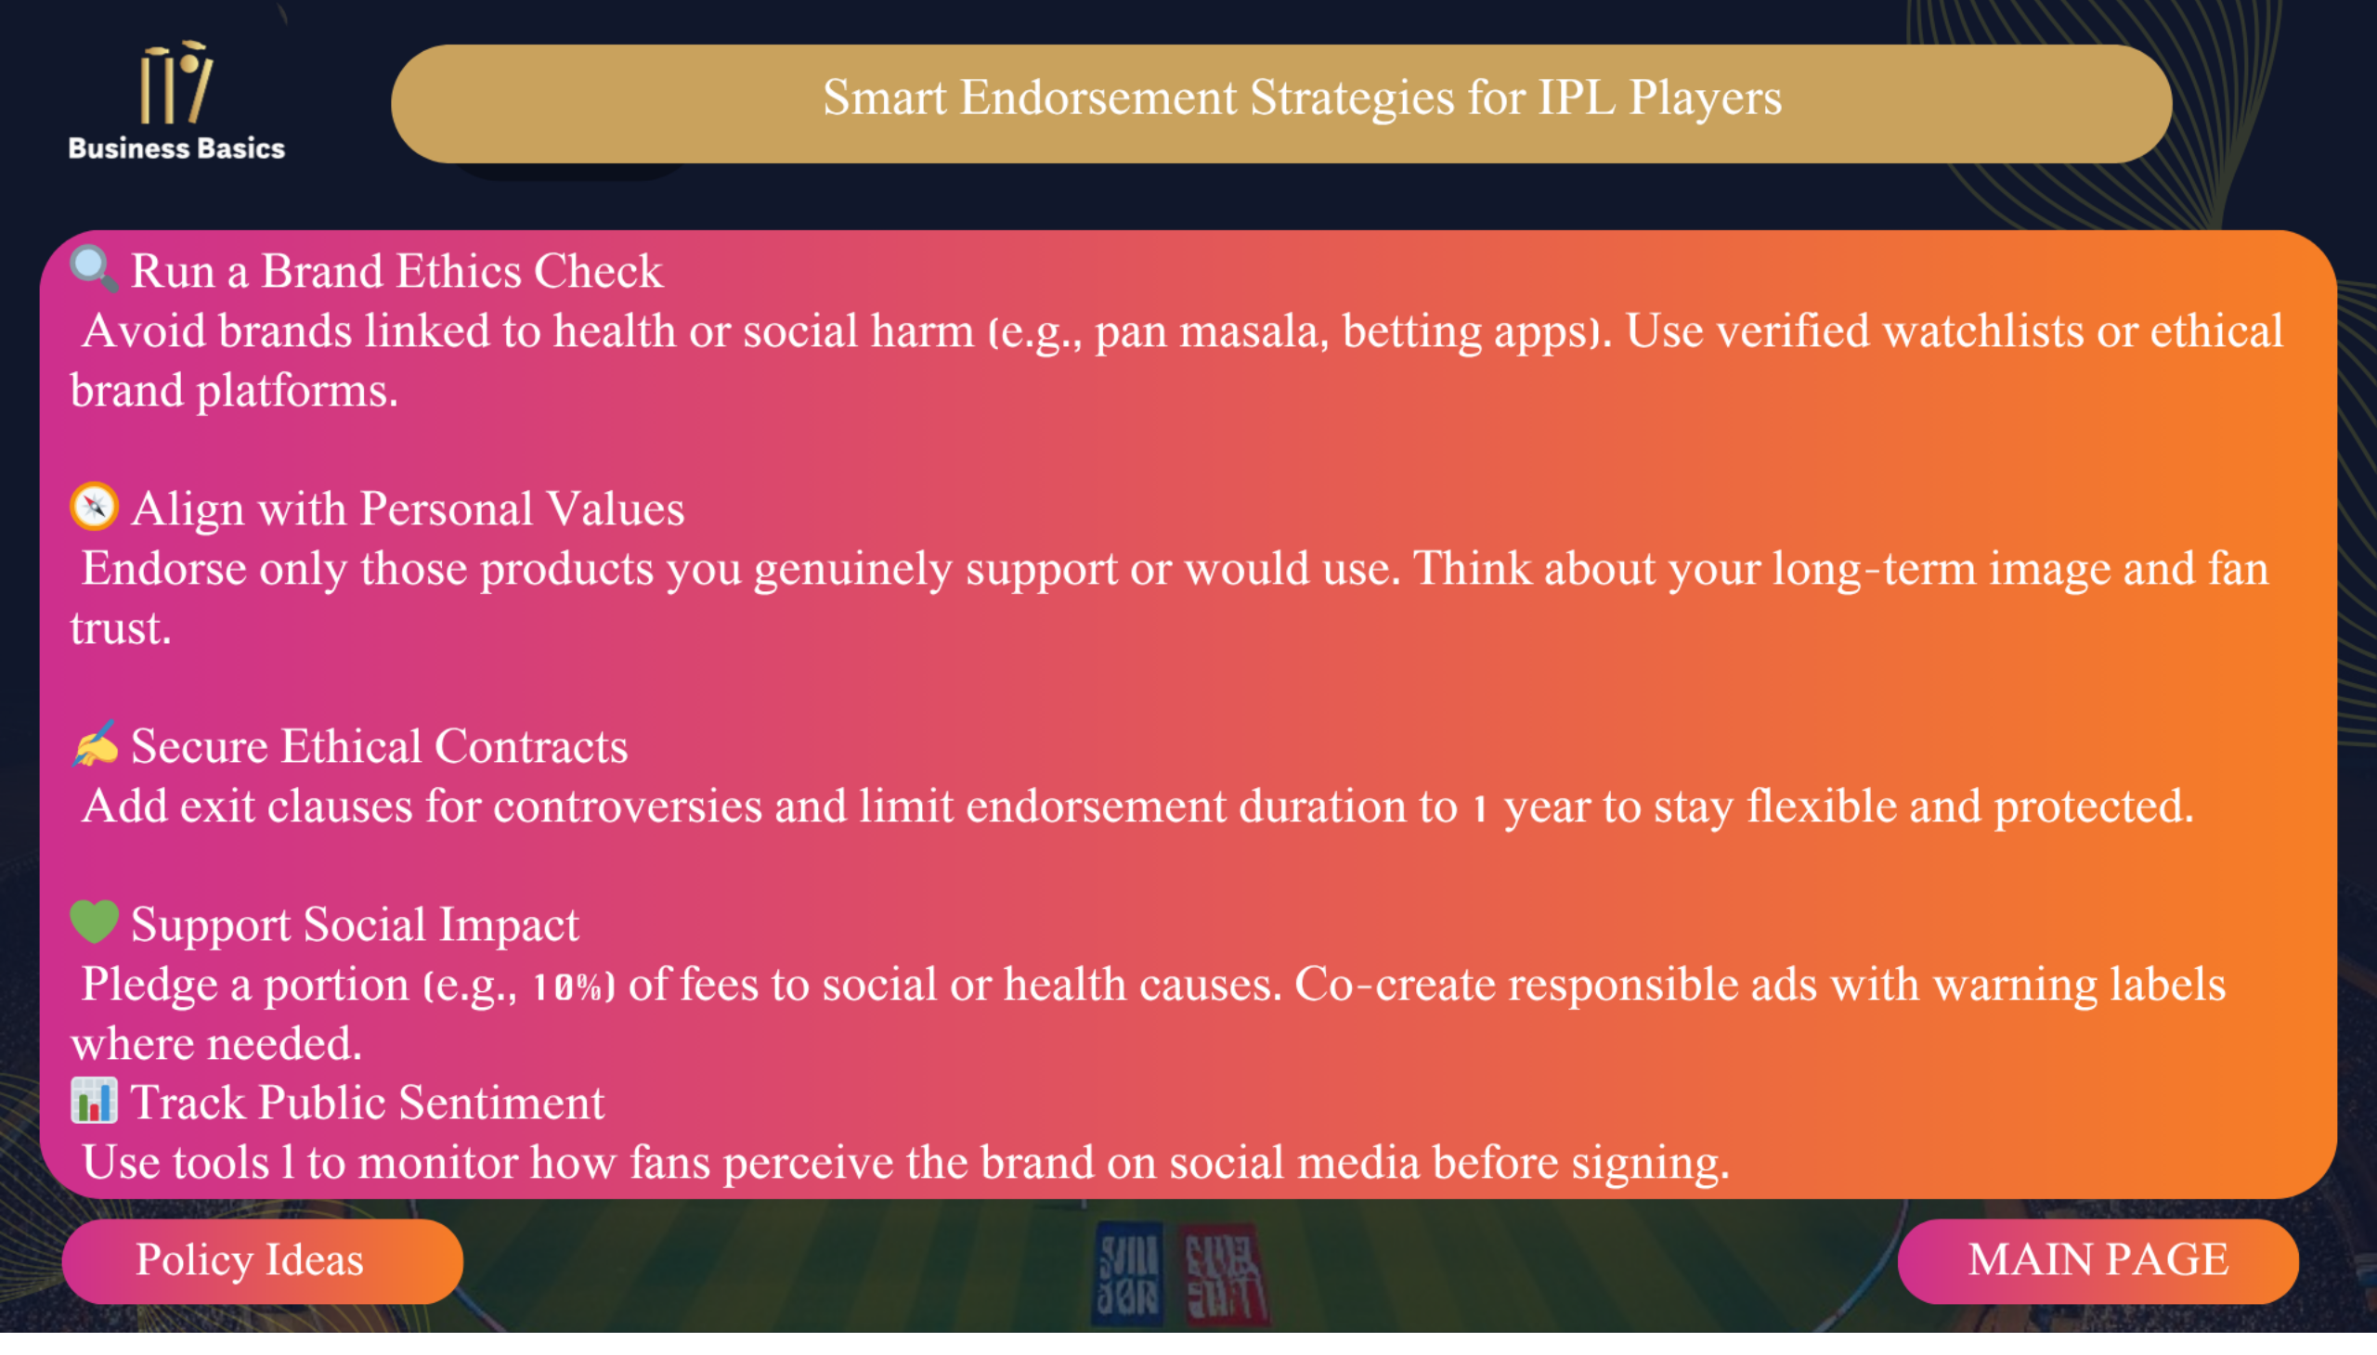
Page 3
Notes:
actionButton
No alt text provided
actionButton
No alt text provided
actionButton
No alt text provided

